Slide 1
Introduction to SMART on FHIR
Application Architecture
SMART on FHIR Application Architecture
SMART on FHIR Application Workflow
SMART on FHIR Application Implementation
Notes:
Welcome to our introduction to SMART on FHIR Application Architecture

Slide 2

Most of the Concepts We Will Discuss Are Trademarked
Notes:
Many of the concepts included in this presentation are trademarked including those shown here.

Slide 3
Most of the Information Provided Here Comes from Other Sources (including the following)
References:
Mandel, Josh, SMART on FHIR (from DevDays, Richmond, 2019) available at https://www.youtube.com/watch?v=N0PXAxBA-J8&t=112s
Cannon, Renee, SMART on FHIR: The Basics, available at https://www.youtube.com/watch?v=MMfe181tmwU
The Cerner SMART on FHIR Tutorial, available at https://engineering.cerner.com/smart-on-fhir-tutorial/
Notes:
Most of the information in this presentation comes from other sources including those shown here.

Slide 4
Introduction
This Presentation focuses on SMART on FHIR applications launched from an EMR
This presentation gives an introduction to SMART on FHIR application architecture including
An overview and details of the architecture of SMART on FHIR with examples
The work flow of a typical SMART on FHIR application
An example SMART on FHIR application that can be deployed and demonstrated using the SmartHealthIt EMR simulator (sandbox)
Notes:
This presentation will consider the use case of launching a SMART on FHIR application from and EMR
SMART on FHIR can be used in a stand-alone application but we will not be looking at that use case here
This presentation gives an introduction to SMART on FHIR including application architecture, work-flow, and we will provide a demonstration of a working SMART on FHIR application that you can checkout of github and use yourself.

Slide 5
What is SMART on FHIR?
SMART on FHIR is the glue that connects an application to a clinical system
Notes:
Remember from our Introduction to SMART on FHIR materials that SMART on FHIR is the glue that connects an application (business logic) to a clinical system (data layer)
From a logical (abstract) perspective this looks like the diagram shown here

Slide 6
SMART on FHIR Components
High level component diagram for a typical SMART on FHIR Application
Notes:
Looking at an actual implementation of a SMART on FHIR application we can create a physical model of the components that implement each of these layers.
For our example
The application layer will be the 005-serverside application we check out of Github
The Integration Layer is the SMART on FHIR Javascript library that encapsulates and provides all of the functionality we need for the SMART on FHIR launch and to interact with the FHIR patient server including reading and writing data to the EMR (more precisely, the EMRs underlying Patient FHIR server)
In short
We have an application that implements our business logic
That application contains the fhir-client javascript library that encapsulates all of the details of how to launch our application and how our application can interact with our EMRs Patient FHIR server
We are going to register our application with our EMR stand-in, the SmartHealthIt sandbox) and then launch our application from our stand-in for the EMR

Slide 7
SMART on FHIR Application Workflow
Register application with the EMR
EMR User triggers launch event (e.g. “select user event”)
Registered SMART on FHIR applications are “notified”
i.e. a http request is sent to the URL registered by the application
The SMART on FHIR application is “launched”
e.g. the SMART on FHIR application is displayed in the EMR
As part of the workflow of the SMART on FHIR application can make read and/or write requests to the EMR’s FHIR Patient server
i.e. FHIR Resources/Requests are sent to the EMR’s Patient server through http (REST) requests
Notes:
This is the basic workflow for a SMART on FHIR application launched from within an EMR
We’ll look at this as a workflow diagram in the next slide and…
We will go through the details of each step in the subsequent slides

Slide 8
SMART on FHIR Workflow Overview
The SMART on FHIR application is “registered” with the EMR
An EMR user triggers a launch event
Registered applications are “notified”
The Application launch page uses the SMART on FHIR API to authenticate with the EMR
The EMR redirects to the Application index page to launch the Application
The Application index page is the starting point of the Application and can use the SMART on FHIR API to exchange data with the EMR’s Patient FHIR Server. The application can cycle through other pages just like any other web application
1
2
3
4
5
6
Notes:
Let’s walk through the workflow for launching a SMART on FHIR application from an EMR
The SMART on FHIR application is “registered” with the EMR
An EMR user triggers a launch event
Registered applications are “notified”
The Application launch page uses the SMART on FHIR API to authenticate with the EMR
The EMR redirects to the Application index page to launch the Application
The Application index page is the starting point of the Application and can use the SMART on FHIR API to exchange data with the EMR’s Patient FHIR Server. The application can cycle through other pages just like any other web application

Slide 9
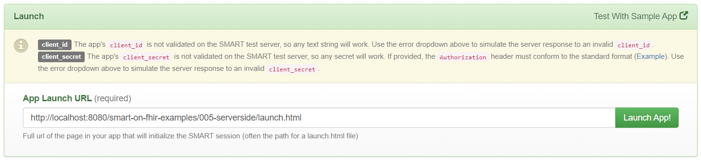
SMART on FHIR Workflow
Register the Application with the EMR and Launch the EMR simulation
Navigate to the SmartHealthIt launch page
https://launch.smarthealthit.org
Enter the URL of our SMART on FHIR Application
http://localhost:8080/smart-on-fhir-examples/005-serverside/launch.html
Press the “Launch App!” button to start the EMR simulation
Notes:
To register our application with the SmartHealthIt sandbox, we simply navigate to the URL shown here and enter the URL of the launch page of our application
We can then simulate an EMR workflow by pressing the Launch button
Let’s look at what happens next and then will look at the details of how it all happened

Slide 10
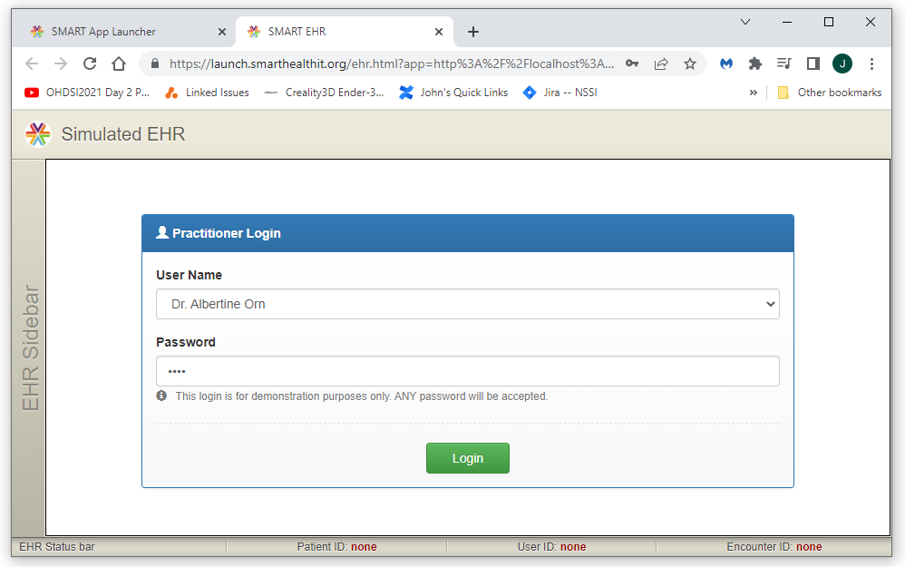
SMART on FHIR Workflow
After hitting the Lauch button, SmartHealthIT sandbox opens the EMR login
Notes:
SmartHealthIT navigates to the logon page for the EMR simulation

Slide 11
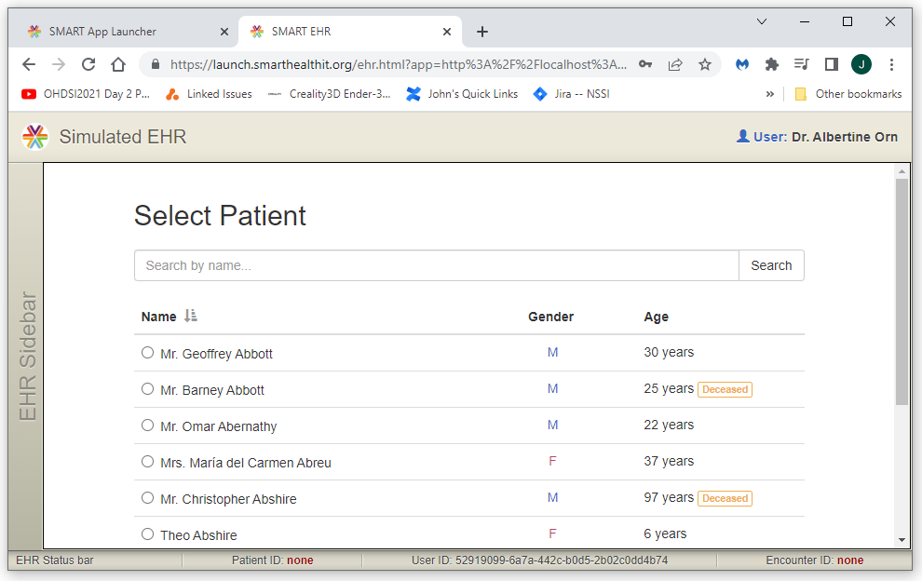
SMART on FHIR Workflow
Select a patient (this will trigger the lauch of our SMART on FHIR application)
Notes:
After we log in we get to select a patient

Slide 12
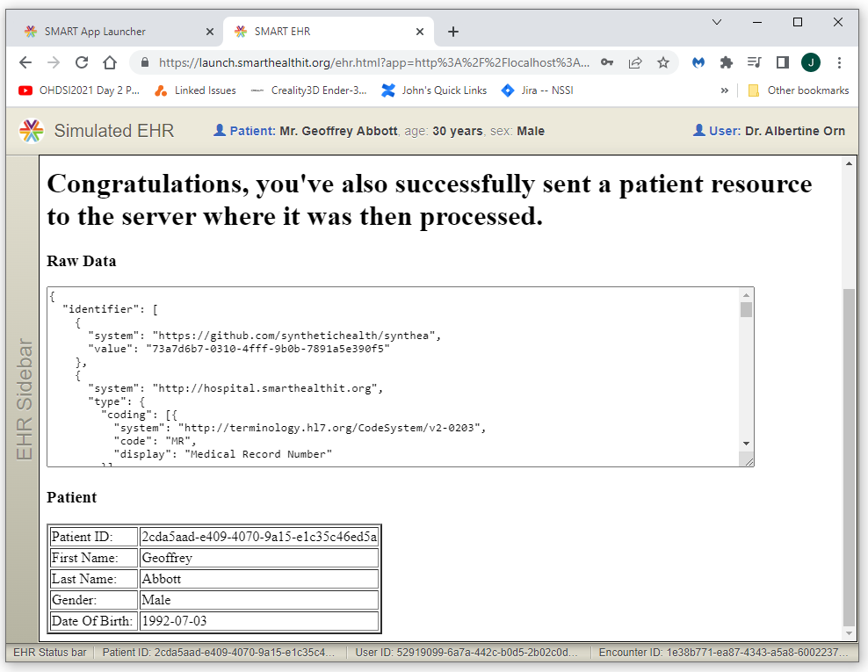
SMART on FHIR Workflow
Our web application has now been called and retrieved data from the EMR
Notes:
Selecting a patient triggers our application
Our application authenticates with the EMR and then
Our application gets patient data from the EMR

Slide 13
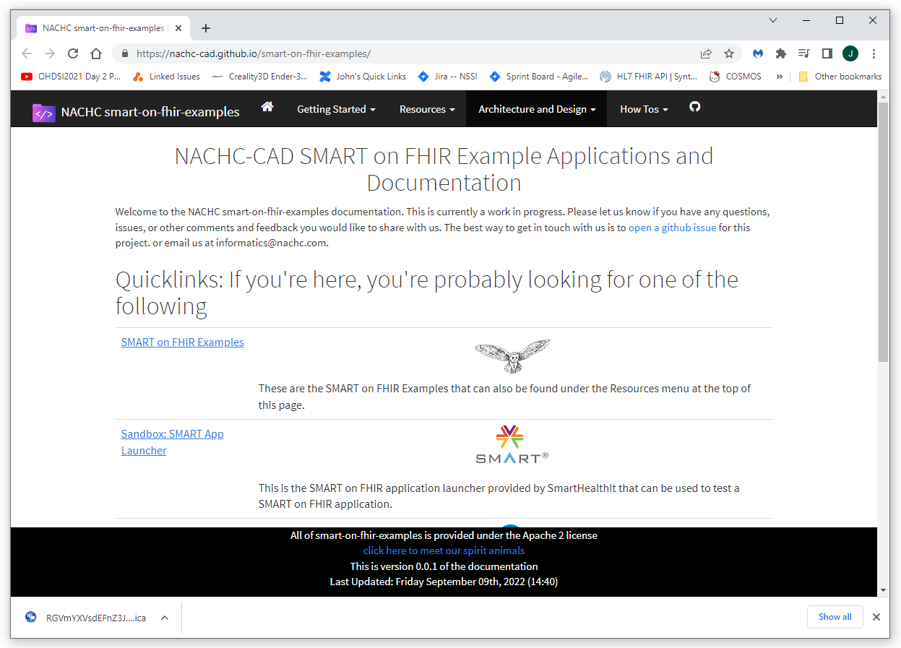
SMART on FHIR Workflow
How it all works: The SMART on FHIR examples application
Github URL: https://github.com/NACHC-CAD/smart-on-fhir-examples
Documentation: https://nachc-cad.github.io/smart-on-fhir-examples/
Notes:
The application that we used for this example is part of the smart-on-fhir examples application that can be downloaded from Github using the url shown here
Documentation for these examples are linked to from the github repository and are available directly from the documentation link shown here

Slide 14
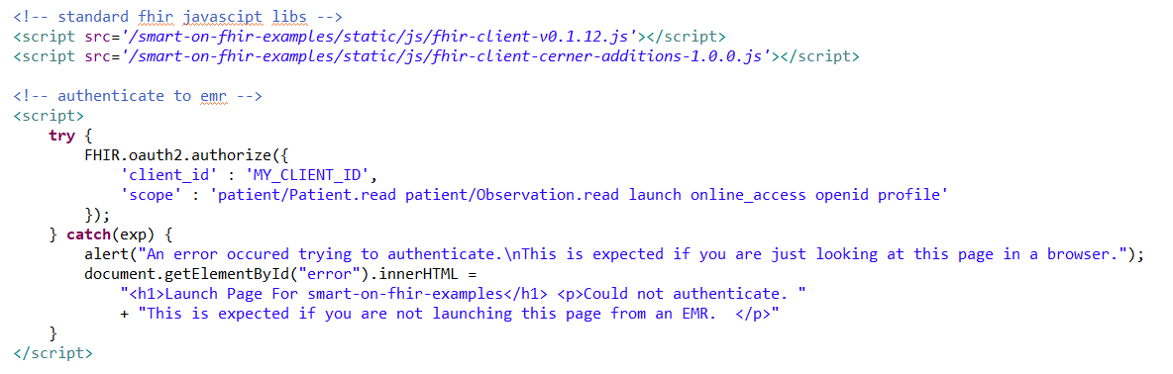
SMART on FHIR Workflow
The launch web page (this is the page we registered with the EMR)
The launch page is very simple
It just sends an authentication request back to the EMR using the SMART on FHIR API as shown here
When the EMR gets the authentication request the application will redirect to the index page of the application if the authentication request is valid (the index page is shown on the next slide)
Notes:
In our example we used the 005-serverside application
When the SmartHealthIT EMR notified our application, it sent a request to the url for the launch page at the url shown (this was the url we registered initially)
The launch page is very simple
It just sends an authentication request back to the EMR using the SMART on FHIR API as shown here
When the EMR gets the authentication request the application will redirect to the index page of the application (if the authentication request is valid)
We’ll look at the index page on the next slide

Slide 15
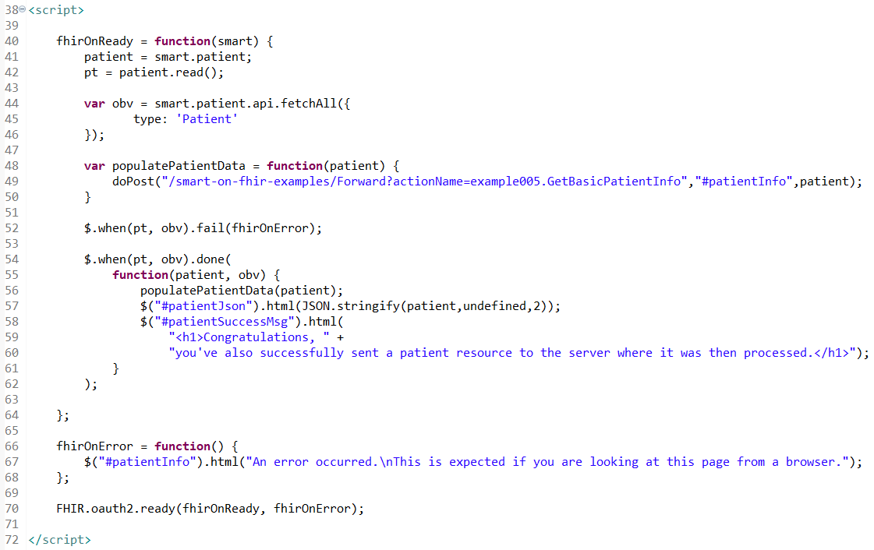
SMART on FHIR Workflow
The index web page (this is the starting point of our business logic)
Notes:
This is the index page that is called by the EMR after authentication
When this page is call, parameters are included in the request that give us access to the FHIR Patient server used by the EMR
This code uses the JQuery library. The $ commands are JQuery commands
Looking at the code…
There are three major sections
One, A success function
Two, An error function
The call to the FHIR authentication API
Starting from the end
On Line 70 we see the call to the SMART on FHIR API using the FHIR Javacript object
This call sends an authentication request to our EMR and defines what calls to make for
Success (the first parameter)
Error (the second parameter)
We can see on line 70 that
The success function is the fhirOnReady function that we define above starting on line 40
The error function is the fhirOnError function that starts on line 66
The fhirOnError function is fairly easy to understand
This function basically says populate the element with an id of “patientInfo” with the html pasted in to the function
The fhirOnReady function is where the magic happens
On line 41 we see a variable called “smart” being accessed in the call patient = smart.patient;
This “smart” variable is a variable that has been put into our context by the response from our authentication request to the EMR
This is the Javascript object that gives us access to the EMR Patient FHIR data
Lines 41 and 42 initialize the patient object, however, they do not pull the patient data into our application
To get the patient data, we need to do the fetchAll call seen on line 44
With in the fhirOnReay function, we define the functions that are called on error and on success of the fhirOnReady function
The fail function on line 52 simply calls the fhirOnError function that starts on lin 66
The success function (done) starts on line 54
On line 56 this function calls populatePatientData and this calls our GetPatientInfo servlet
This servlet parses the patient JSon string using the HAPI FHIR library and populates the patient table seen in the returned page using a forward to a jsp (see the GetBasicPatientInfo action class for details)
On line 57 the text area is populated with the raw JSon of the Patient object
On line 58 the element with an id “patientSuccessMsg” is populated with the specified html
Thereby, our application has now been launched from the EMR and used the SMART on FHIR Javascript API to get patient data from the EMR
This is the end of this example

Slide 16
Summary
This concludes our introduction to SMART on FHIR application architecture
What we’ve learned
We’ve gained an understanding of the components and the architecture of a SMART on FHIR application that is launched from an EMR using an example application and the SmartHealthIt sandbox
The work-flow of a typical SMART on FHIR application launched from an EMR
What the code in an example SMART on FHIR application does to enable a SMART on FHIR launch from and EMR and use the SMART on FHIR API to interact with that EMR using FHIR

Slide 17
Next Steps
Deploying a SMART on FHIR application to the Web
The next presentation in this series is “Deploying a SMART on FHIR application to the Web Using AWS EC2
This tutorial will walk you through all of the steps required to set up a Java application server (Wildfly) and deploy a SMART on FHIR application to the web for public consumption using Amazon Web Services (AWS)

Slide 18


